Slide 1
Potato Chip Mailing Contest
Group 3

Slide 2
Objective/Requirements
Build a….. 5 by 5 by 3 inch tall box. Put the pringle in a pvc pipe and pack it in the pvc pipe with cotton balls and seal the ends of the pvc pipe with duct tape. Suspend the pvc pipe with rubber bands from each corner of the box. Finally fill the rest of the box with packing peanuts or cotton balls and seal the box

Slide 3
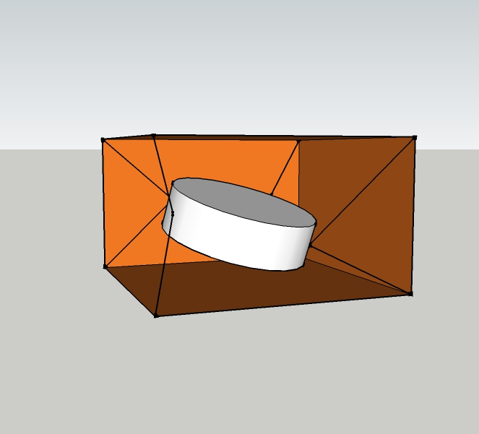
Design

Slide 4
Predicted Score with Explanation
0.62

Slide 5
Parts List
*5 by 5 by 3 inch box
*thick rubber bands
*pvc pipe
*packing peanuts or cotton balls

Slide 6
Photo of Mailed Container

Slide 7
Data
Official Score

Slide 8
Lessons Learned
What worked well
What would you change next time
If your predicted score differed from your actual, why?

